Slide 1

CSC 533: Privacy in the Digital Age (Fall 2020) Lecture 24: Inference attack on networked devices
Anupam Das
Nov. 10, 2020

Slide 2
Goals for today
Inference attacks on networked devices:
Remote physical device fingerprinting
TCP based clock skew rate
Website fingerprinting
Over encrypted data
IoT device activity
Over encrypted data
Some slide contents have been taken from Steven J. Murdoch, Claudia Diaz

Slide 3
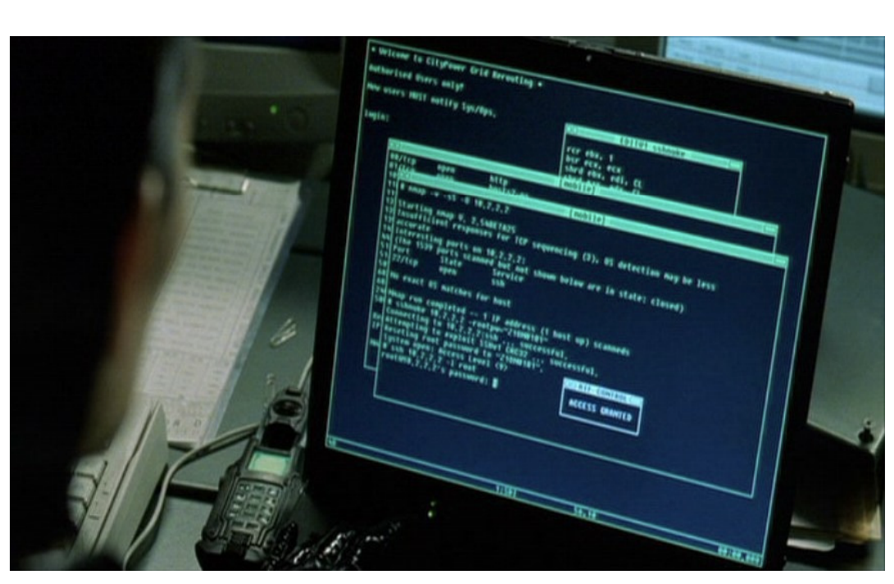
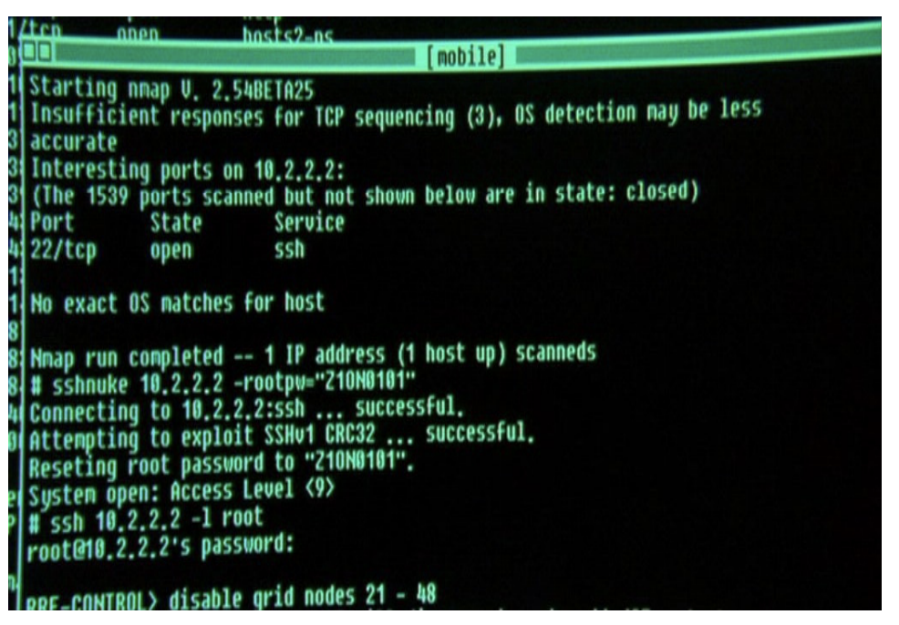
Remote device identification
Where did we see this?
It was running Nmap

Slide 4
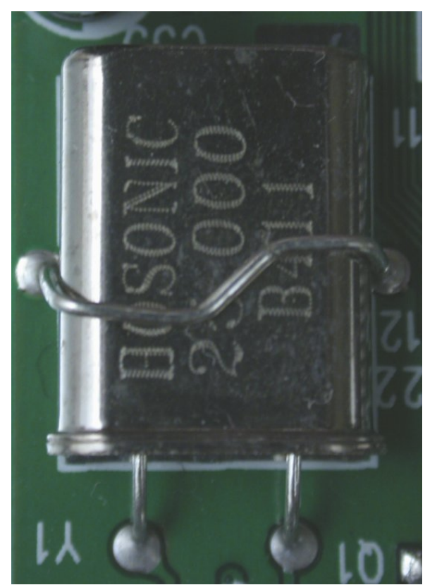
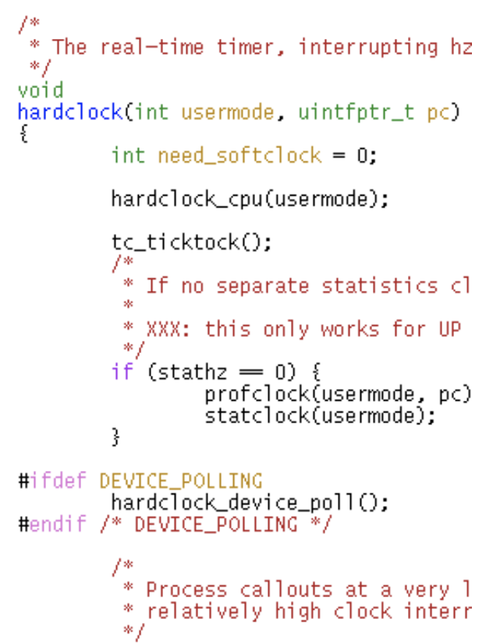
Computers have multiple clocks
A clock consists of an:
• Oscillator, controlled by a crystal, ticks at a nominal frequency
• Counter, counts the number of ticks produced by the oscillator
On FreeBSD there are several clocks available (other OS are similar):
• Tick counter: An uncorrected clock used internally by the OS
• System clock: A clock corrected by NTP (used by applications)
• BIOS clock (also known as CMOS clock): runs even when PC is off

Slide 5
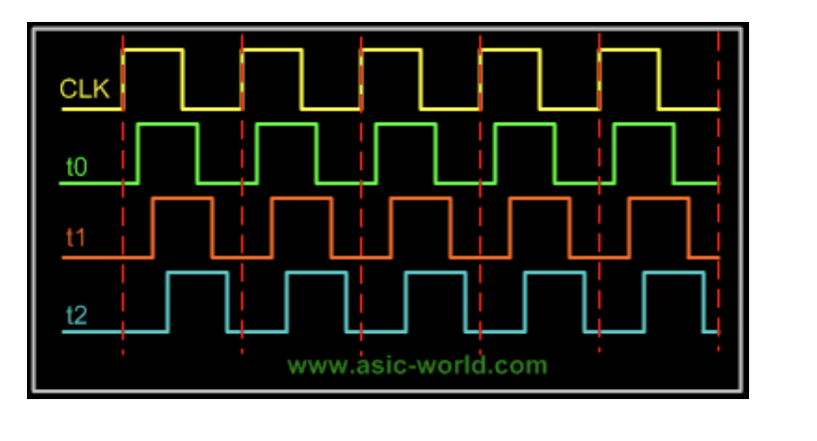
Clock can have inaccuracies
These clocks can have inaccuracies and such inaccuracies can vary across different clocks
Some of these clocks can be queried over the Internet through ICMP and TCP packets

Slide 6
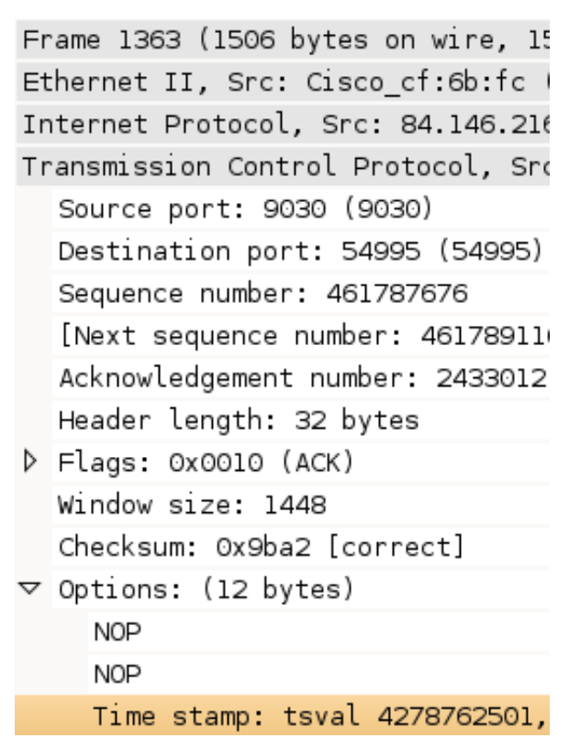
Accessible clocks
• ICMP timestamp request
• Generated from system clock, commonly disabled or blocked by firewalls
• TCP sequence numbers
• Works for Linux, generated from system clock, rewriting needs state on firewalls,
• TCP timestamp
• Newer feature than ICMP timestamps, generated from tick counter, enabled by default on all modern TCP stacks, hard to block on firewalls, required on fast networks

Slide 7
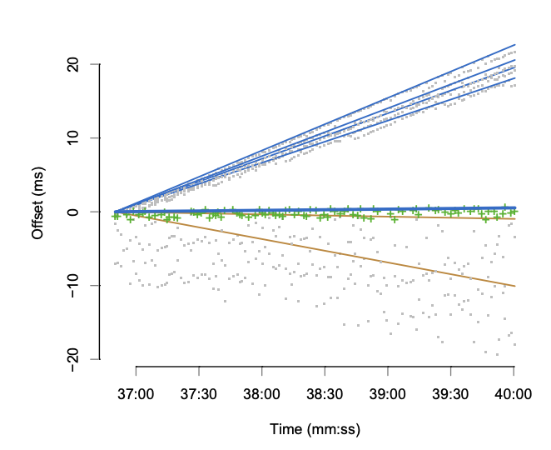
Remote physical device fingerprinting
Offset:
• The difference between two clocks (ms)
Skew:
• The rate of change of offset (ppm)
• Stable on one machine (±1–2 ppm), but varies over different machines (up to ±50 ppm)
• Can give 4–6 bits of information on machine identity
Remote physical device fingerprinting. Tadayoshi Kohno, Andre Broido, kc claffy. IEEE Symposium on Security and Privacy 2005

Slide 8
Impact of remote device identification
Identify machines, as they change IP address, ISP and even physical location
De-anonymize network traces
Detecting whether a host is running on a virtual machine
Confirming whether a group of hosts are running on the same hardware (e.g. a honeynet)
Counting number of hosts behind a NAT
The paper did note that clock skew can be affected by temperature, but did not explore the full potential

Slide 9
Website fingerprinting

Slide 10
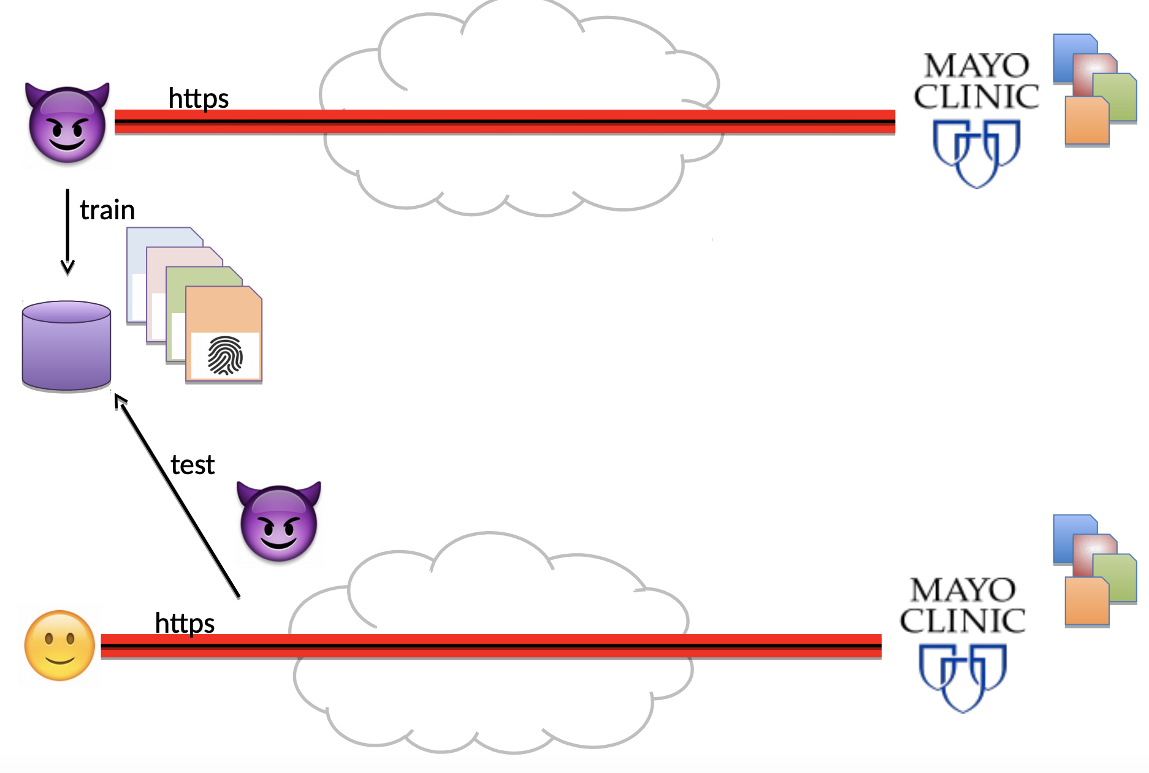
Website fingerprinting
Create a signature or pattern for each site

Slide 11
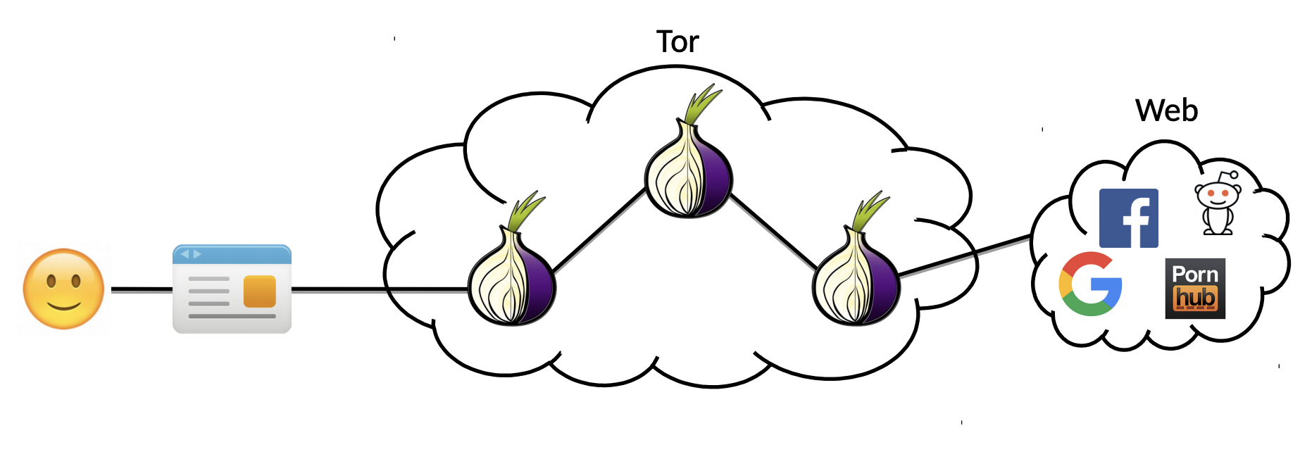
Website fingerprinting (Tor)

Slide 12
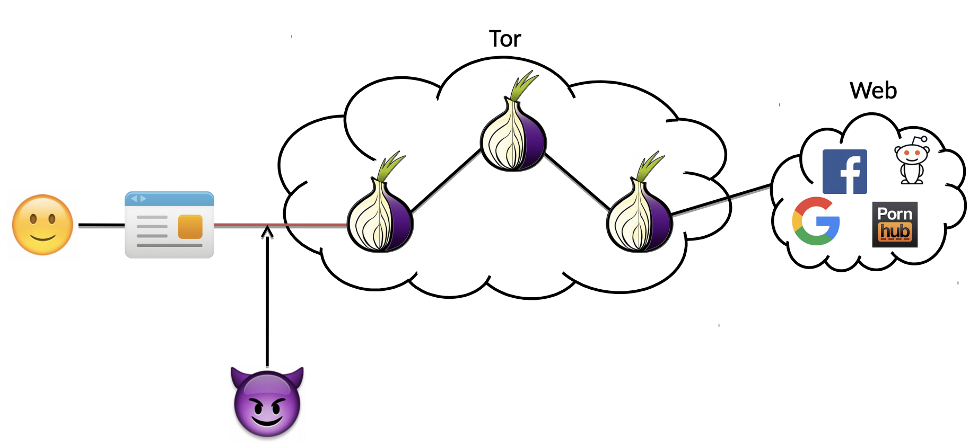
Website fingerprinting (Tor)
Passive adversary: Eavesdrops on packets

Slide 13
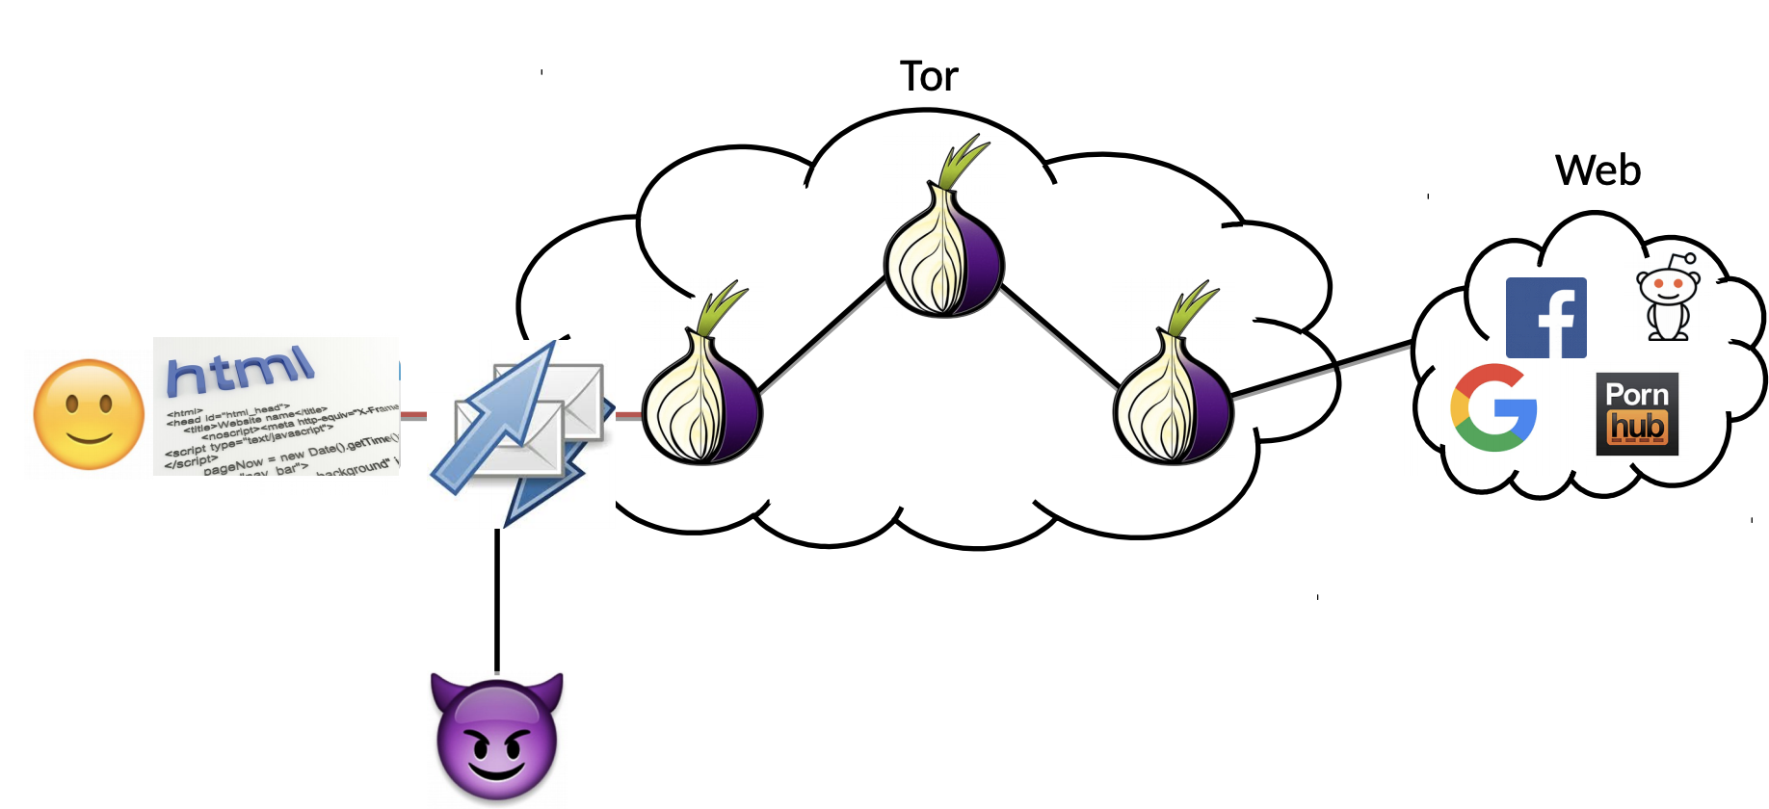
Website fingerprinting (Tor)
Obtain all http level traffic (encrypted)

Slide 14
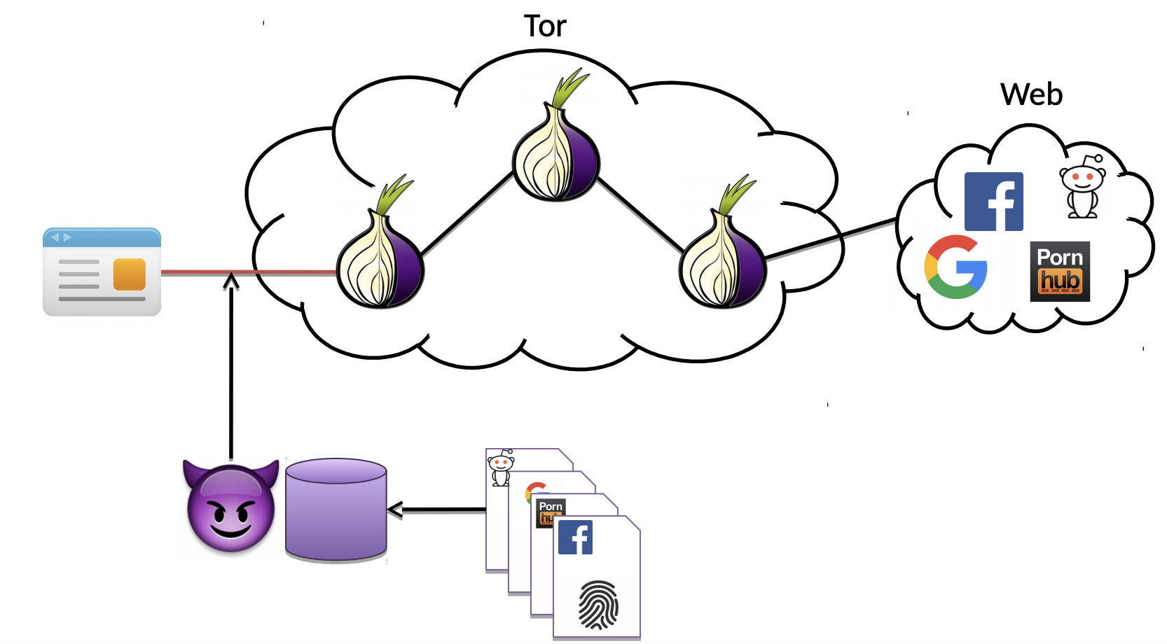
Website fingerprinting (Tor)
Infer what site user is visiting

Slide 15
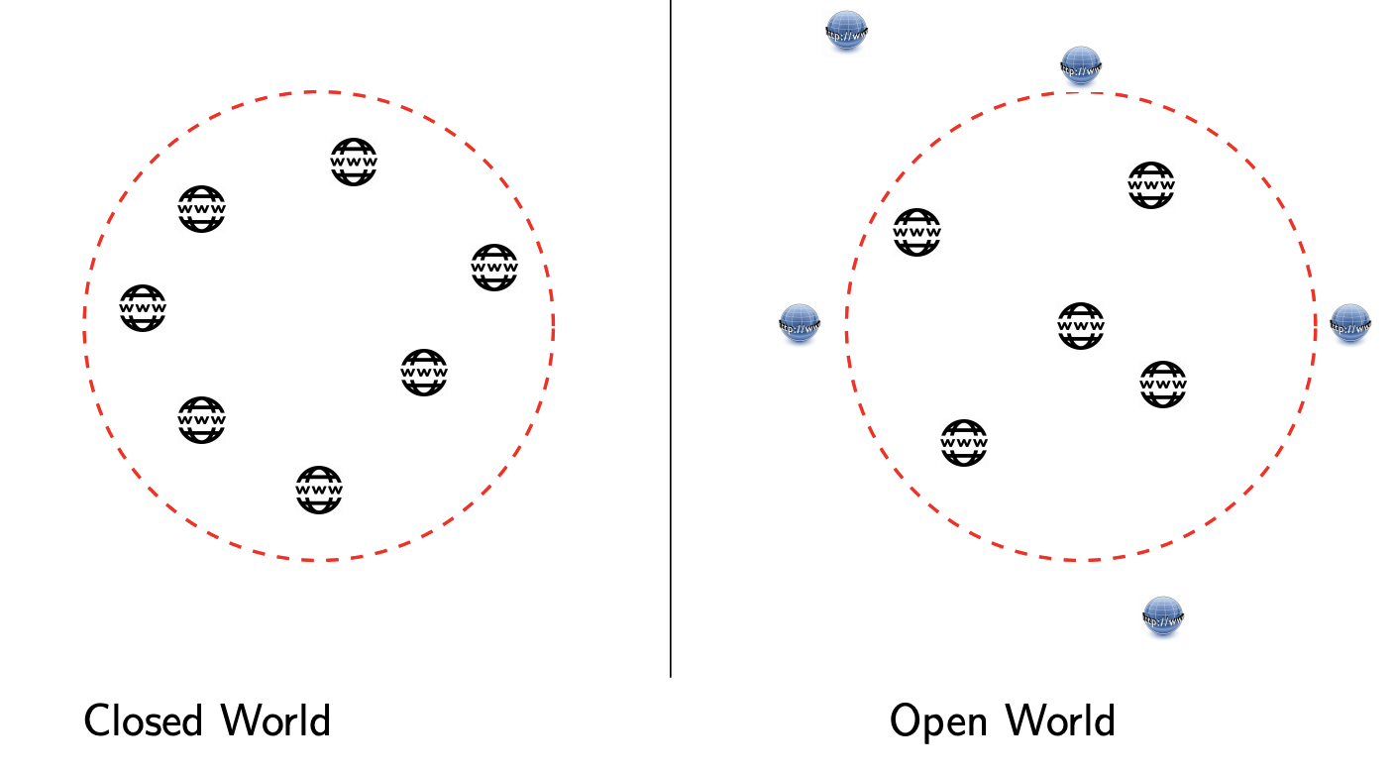
Website fingerprinting (evaluation setup)
Known sites: Fingerprint created
Both Known sites and Unknown sites

Slide 16
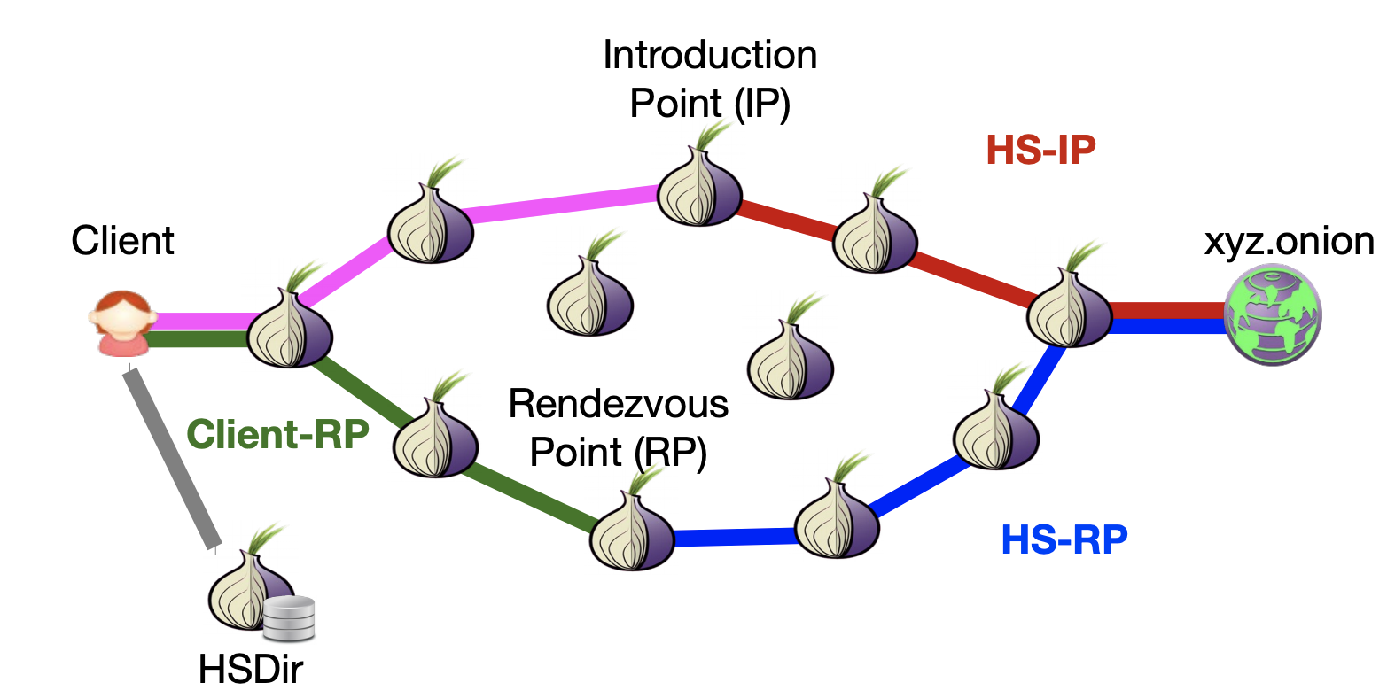
Tor hidden services
HS-RP circuits are distinguishable from normal circuits (Kwon et al, 2015)
Size of the HS world is estimated at a few thousands (closed world!)

Slide 17
Proposed approaches
State of the art attacks:
• kNN
• CUMUL
• k-Fingerprinting
Deep learning techniques have also been explored recently

Slide 18
kNN approach (Wang et al. 2014)
Features
– 3,000
– total size, total time, number of packets, packet ordering
– the lengths of the first 20 packets
– traffic bursts (sequences of packets in the same direction)
Classification –
k-NN – Tune weights of the distance metric that minimizes the distance among instances that belong to the same site.
Results
– 90% - 95% accuracy on a closed-world of 100 non-onion service websites.
Effective Attacks and Provable Defenses for Website Fingerprinting. Tao Wang,; Xiang Cai, Rishab Nithyanand, and Rob Johnson, Ian Goldberg. USENIX Security 2014

Slide 19
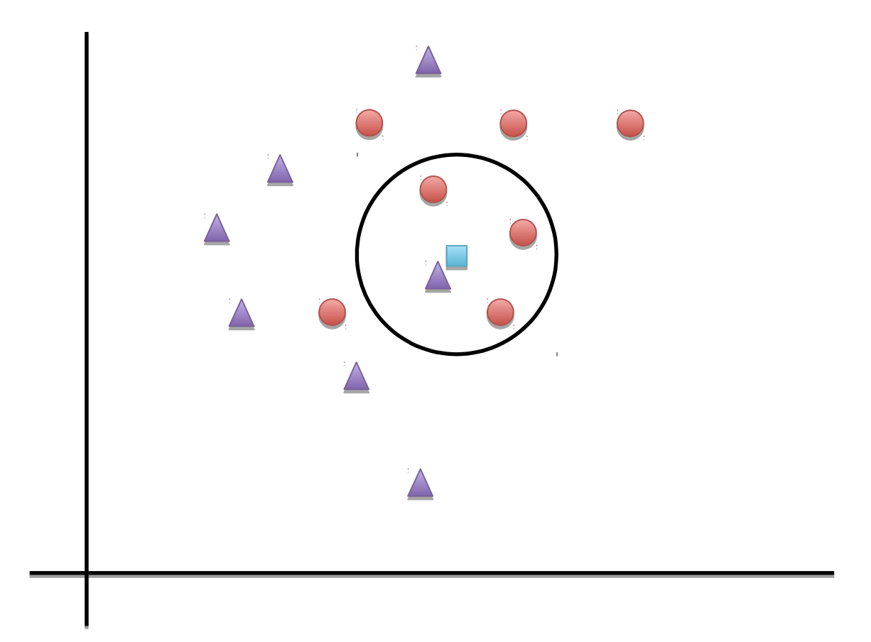
kNN
Computer distance from all training data (labeled)
Identify the k nearest nodes
Majority voting among k nearest nodes’ label

Slide 20
CUMUL (Panchenko et al, 2016)
Features
a 104-coordinate vector formed by the number of bytes and packets in each direction and 100 interpolation points of the cumulative sum of packet lengths (with direction)
Classification – Radial Basis Function kernel (RBF) SVM
Results
– 90% - 93% for 100 Non HS sites
– Open world of 9,000 pages
Website Fingerprinting at Internet Scale. Andriy Panchenko, Fabian Lanze, Andreas Zinnen , Martin Henze , Jan Pennekamp , Klaus Wehrle , and Thomas Engel. NDSS 2016

Slide 21
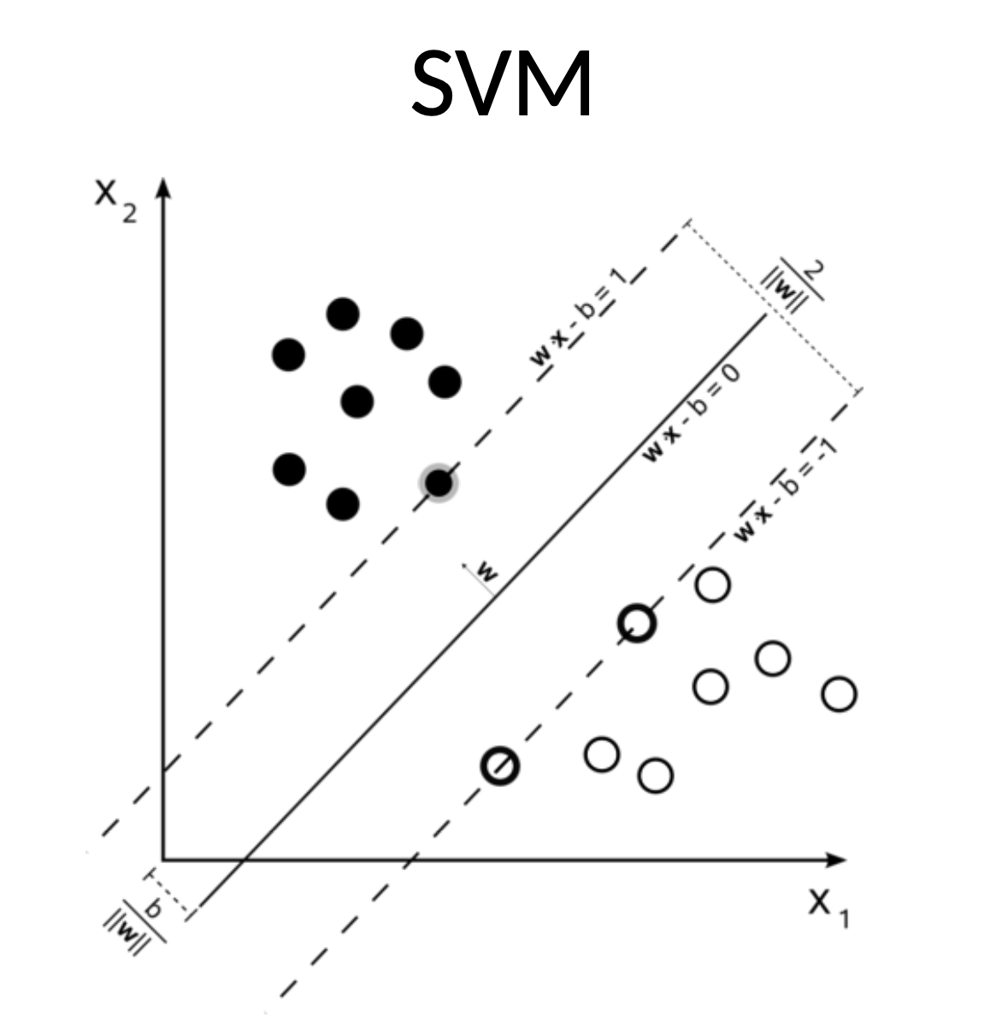
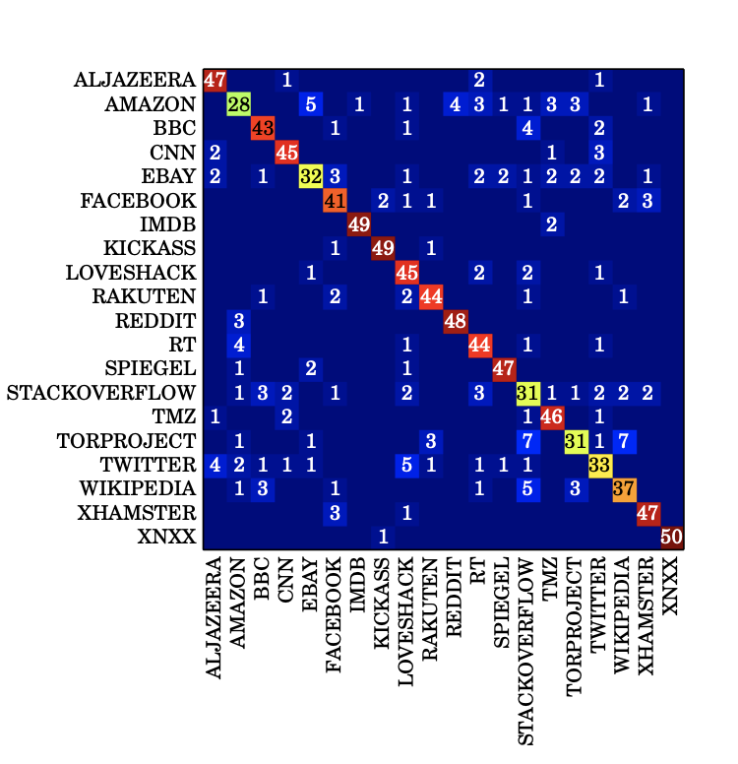
SVM
Multi-class SVM

Slide 22
k-Fingerprinting (Hayes et al, 2016)
Features
175 – Timing and Size features such as #packets/second
Classification – Random Forest (RF) + k-NN
Results
90% accuracy on 30 onion services
Open world of 100,000 pages
k-fingerprinting: A Robust Scalable Website Fingerprinting Technique. Jamie Hayes and George Danezis. USENIX 2016

Slide 23
Real-world implications
Tor is the most advanced anonymity network
WF allows an adversary to discover the browsing history
Can be deployed by a low-resource adversary (that Tor aims to protect against)
Series of successful attacks in the lab
… how concerned should we be about these attacks in practice? – Critical review of WF attacks (Juarez et al, 2014)
A Critical Evaluation of Website Fingerprinting Attacks Marc Juarez , Sadia Afroz , Gunes Acar , Claudia Diaz , Rachel Greenstadt. CCS 2014

Slide 24
Client side assumption
Same browser
One tab

Slide 25
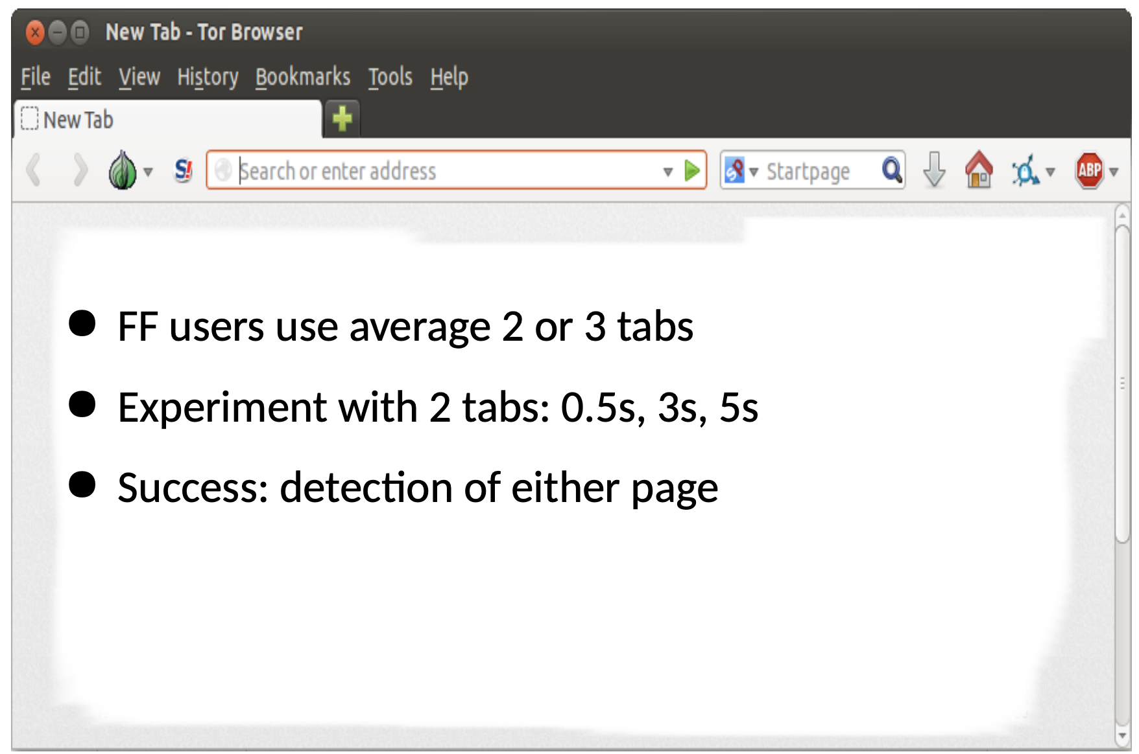
Effect of multi-tab browsing

Slide 26
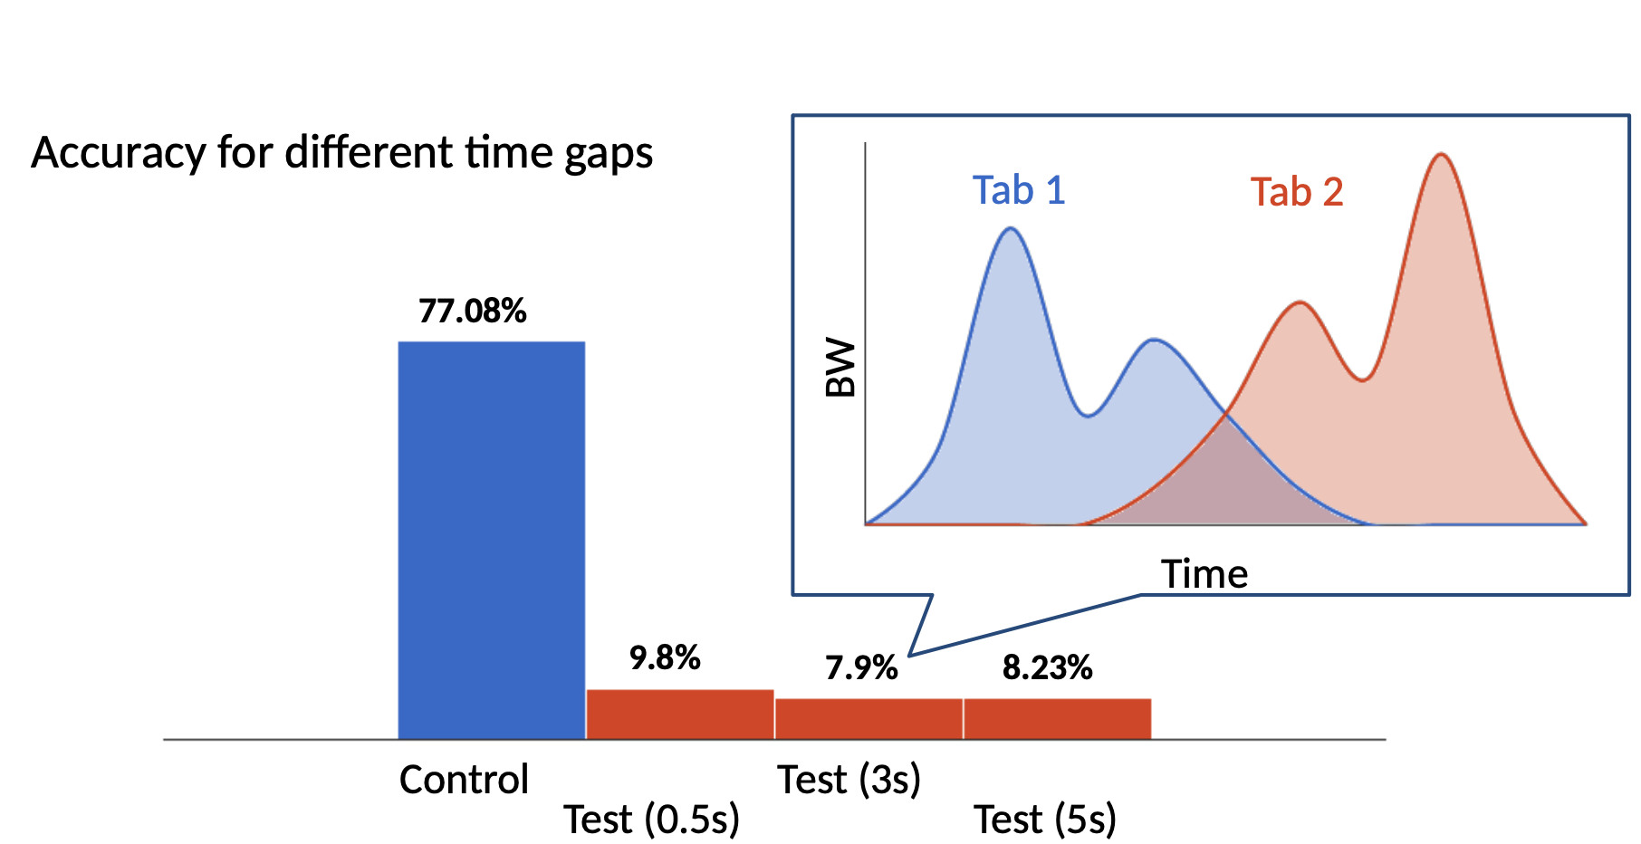
Experiments multi-tab
Trained and test on one tab

Slide 27
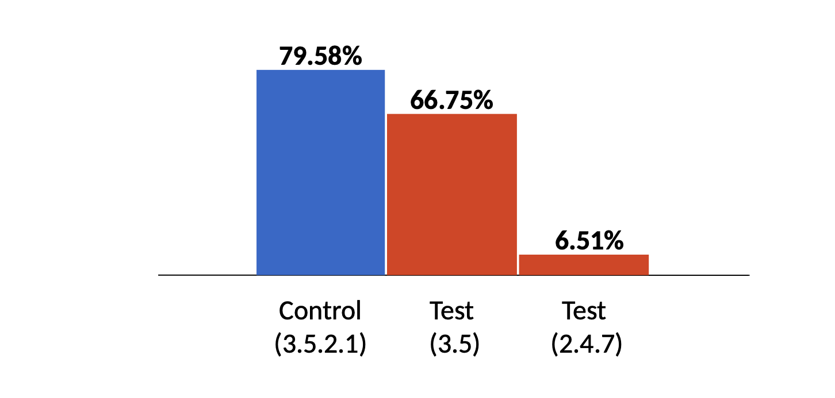
Experiments: TBB version
TBB: Tor Browser Bundle
Several versions coexist at any given time

Slide 28
Adversary side assumption
Adversary: e.g., replicability

Slide 29
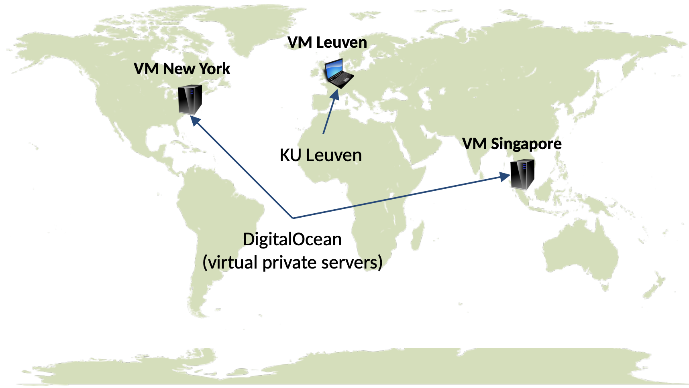
Experiments: network conditions

Slide 30
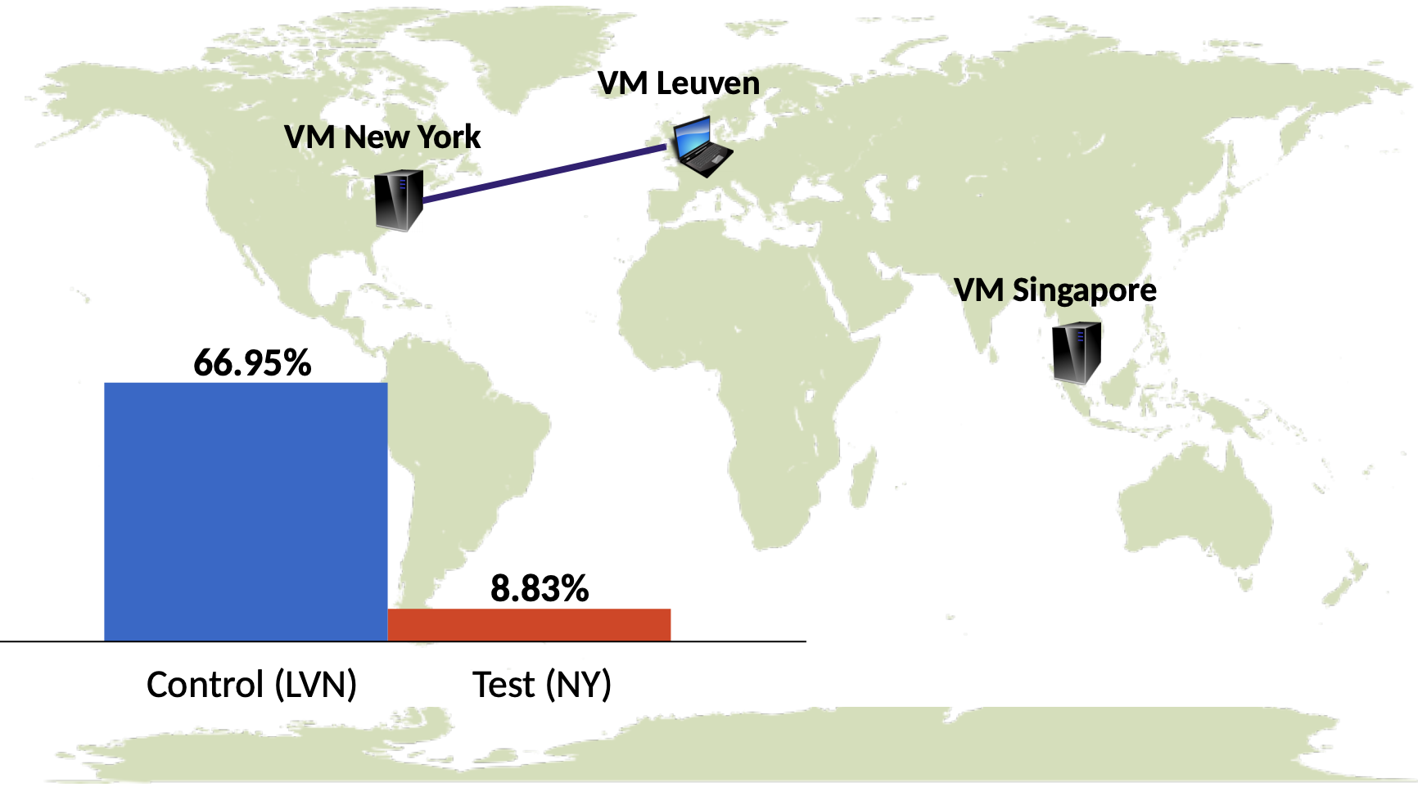
Experiments: network conditions

Slide 31
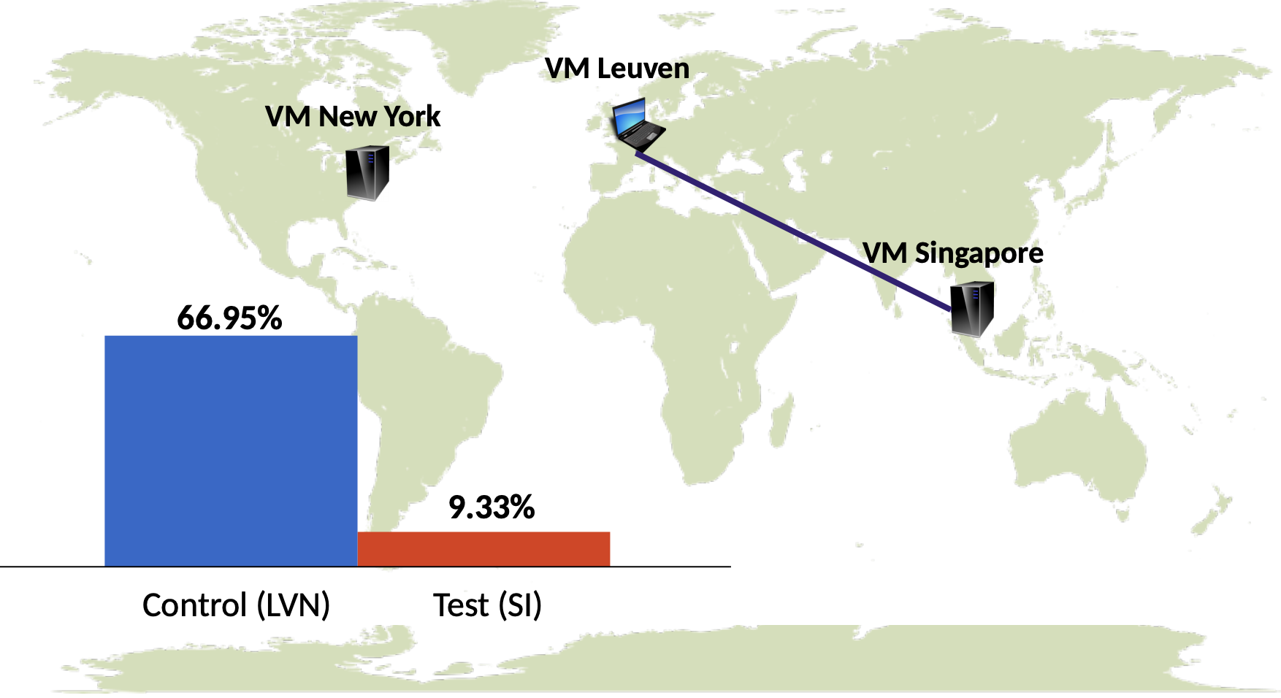
Experiments: network conditions

Slide 32
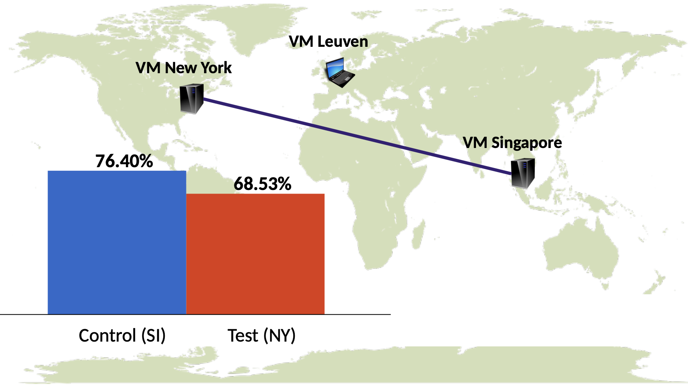
Experiments: network conditions

Slide 33
Experiments: network conditions
Web: e.g., staleness

Slide 34
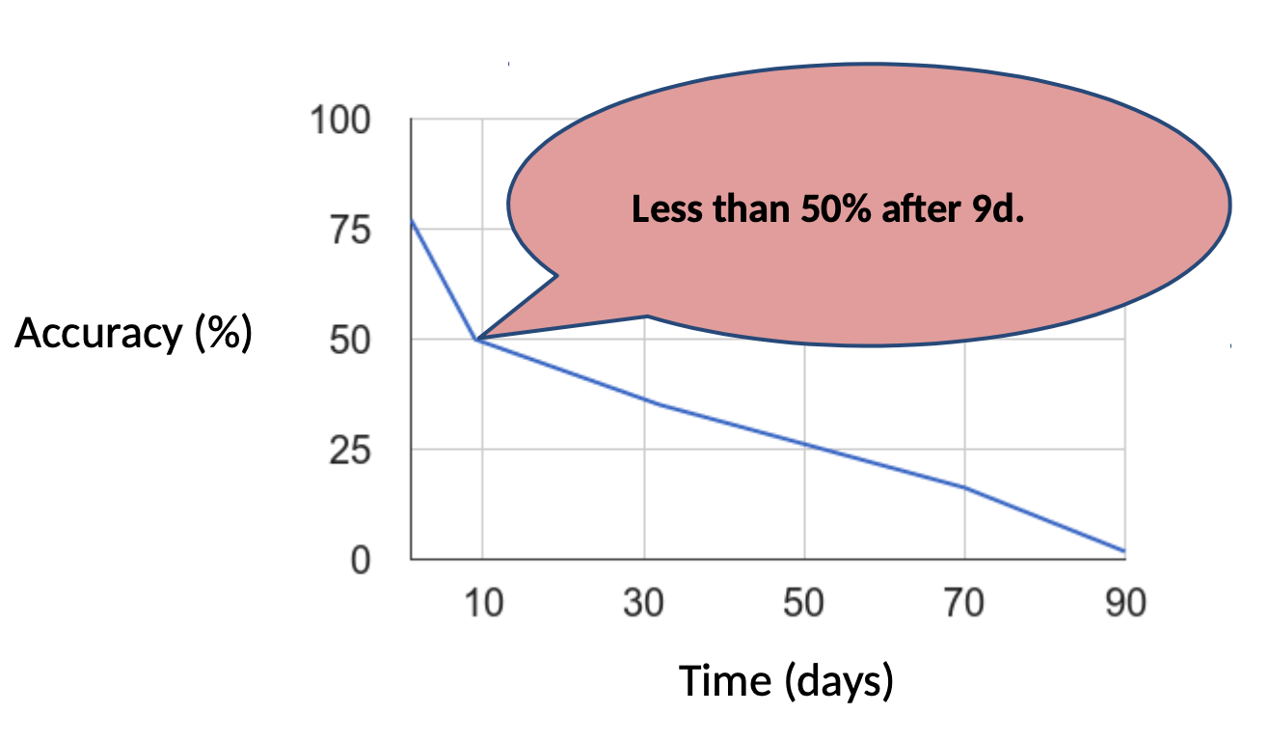
Data staleness

Slide 35
Disparate impact
WF normally attacks report average success
But… – Are certain websites more susceptible to website fingerprinting attacks than others? – What makes some sites more vulnerable to the attack than others?
How Unique is Your. onion? An Analysis of the Fingerprintability of Tor Onion Services. R Overdorf, M Juarez, G Acar, R Greenstadt, C Diaz. CCS 2017

Slide 36
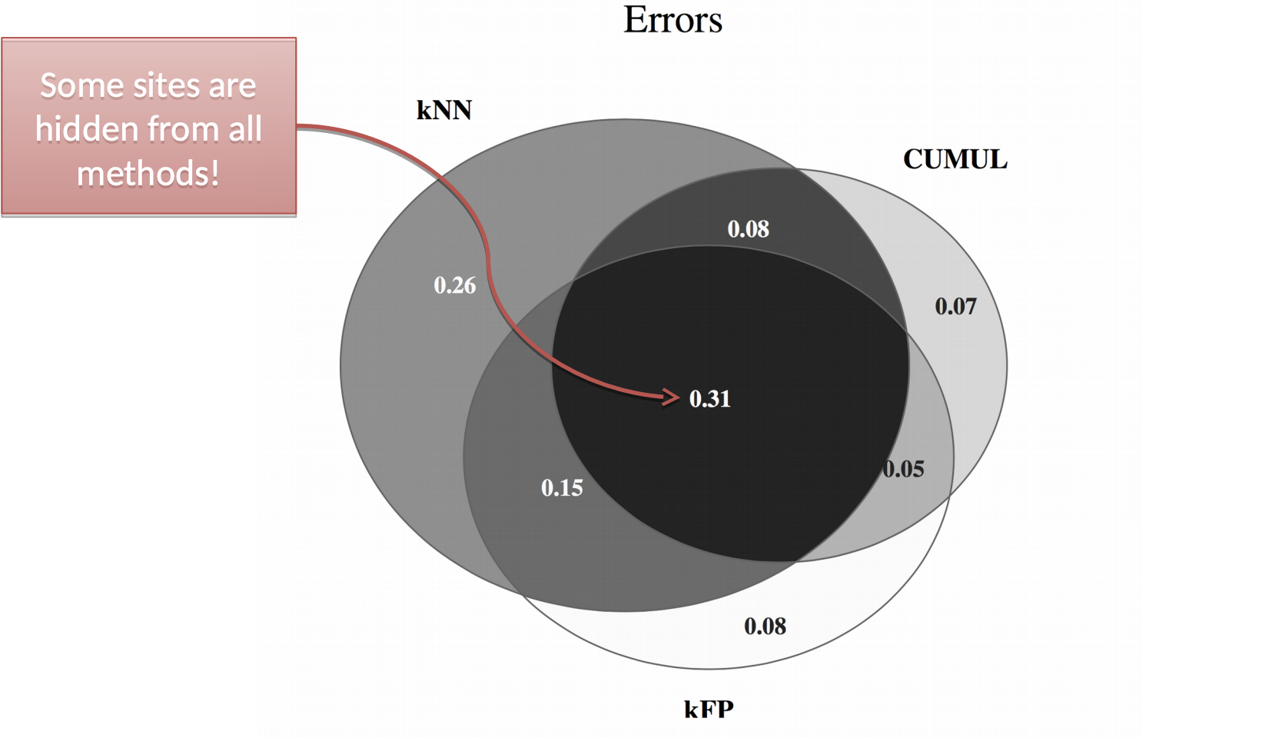
Misclassifications of onion services: Sites that are “safe”

Slide 37
Site-level Feature Analysis
Trace features are not always helpful
Can we determine what characteristics of a website affect its fingerprintability?
Site-Level Features:
– Total HTTP download size – http duration
– screenshot size
– number of scripts

Slide 38
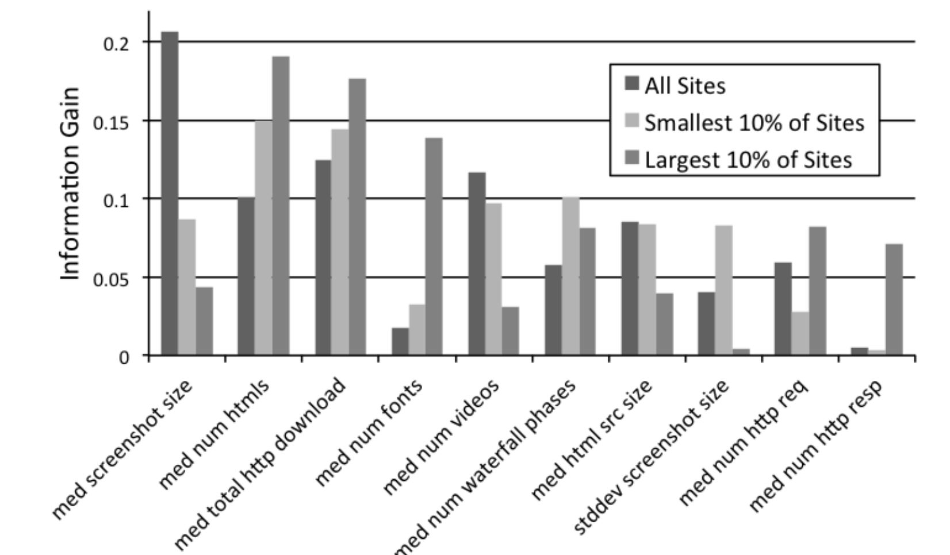
Site Level Feature Analysis

Slide 39
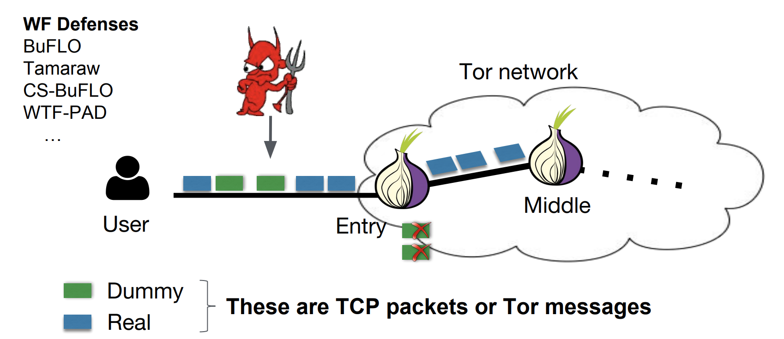
WF countermeasures

Slide 40
WF countermeasures
Network layer
Add padding
Constant rate is unreasonable
Leakage: how to optimize padding?
Add latency to disrupt the traffic pattern
Bad idea
Page design
Small size
Dynamism

Slide 41
Inference in IoT
Notes:
As I embark on my future research challenges, I hope to stimulate interdisciplinary research among researchers from HCI, ubiquitous computing, signal processing and even public policy.

Slide 42
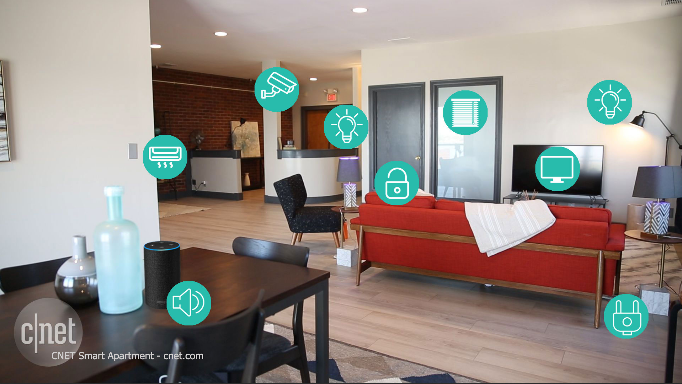
Welcoming IoT devices into our homes
57% of Americans say that having smart products in their house saves them about 30 minutes per day
47% of Millennials already own some devices
70% who already own one product are planning to buy another one
Smart house market will approach 40 billion USD in the US alone by 2020
https://www.alarms.org/smart-home-statistics/
https://www.alarms.org/smart-home-statistics/

Slide 43
Two forms of inference
Infer device type
What devices there are inside the home?
Infer device-level activity
What are the devices doing?

Slide 44
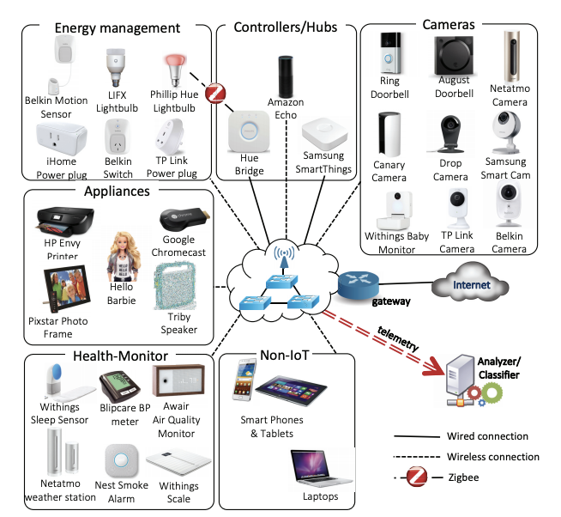
Experimental setup
Log all traffic going through the router
Based on MAC or local IP separate out the flows
For each flow look at different characteristics
Destination
Port
Protocol
Packet size

Slide 45
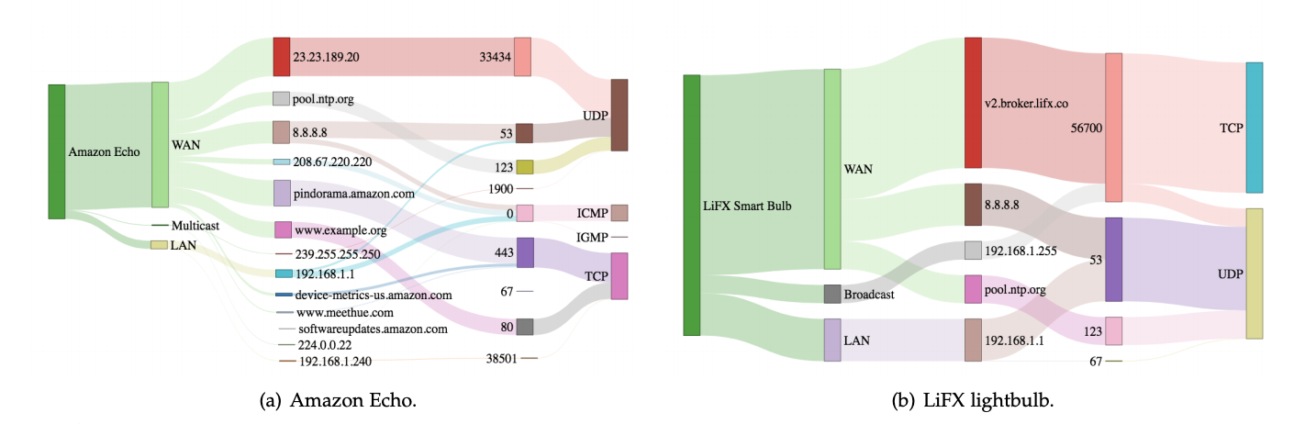
Destinations, ports and protocols

Slide 46
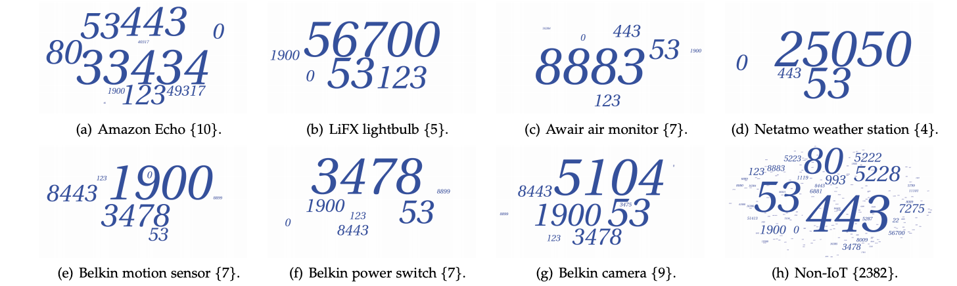
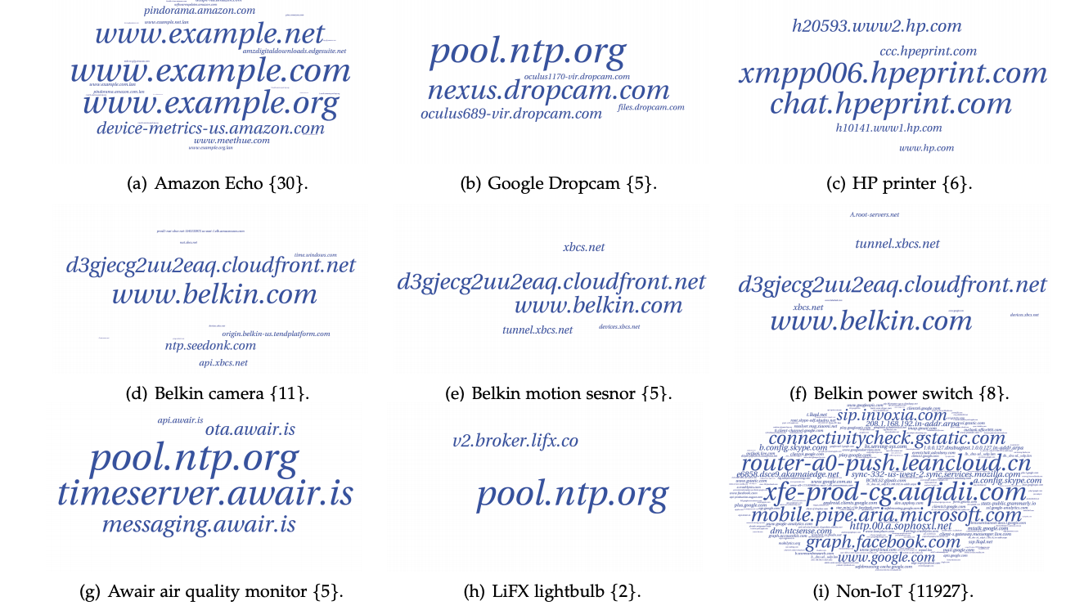
Closer look at ports and destinations
Ports
Destinations

Slide 47
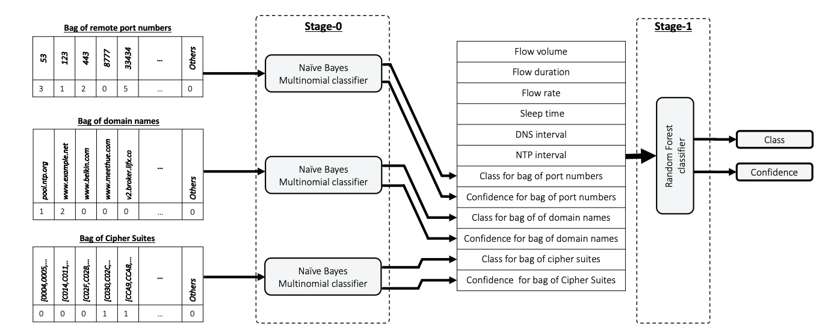
Multi-level classifier
A. Sivanathan, H. Habibi Gharakheili, F. Loi, A. Radford, C. Wijenayake, A. Vishwanath and V. Sivaraman, "Classifying IoT Devices in Smart Environments Using Network Traffic Characteristics", IEEE Transactions on Mobile Computing, 2018.

Slide 48
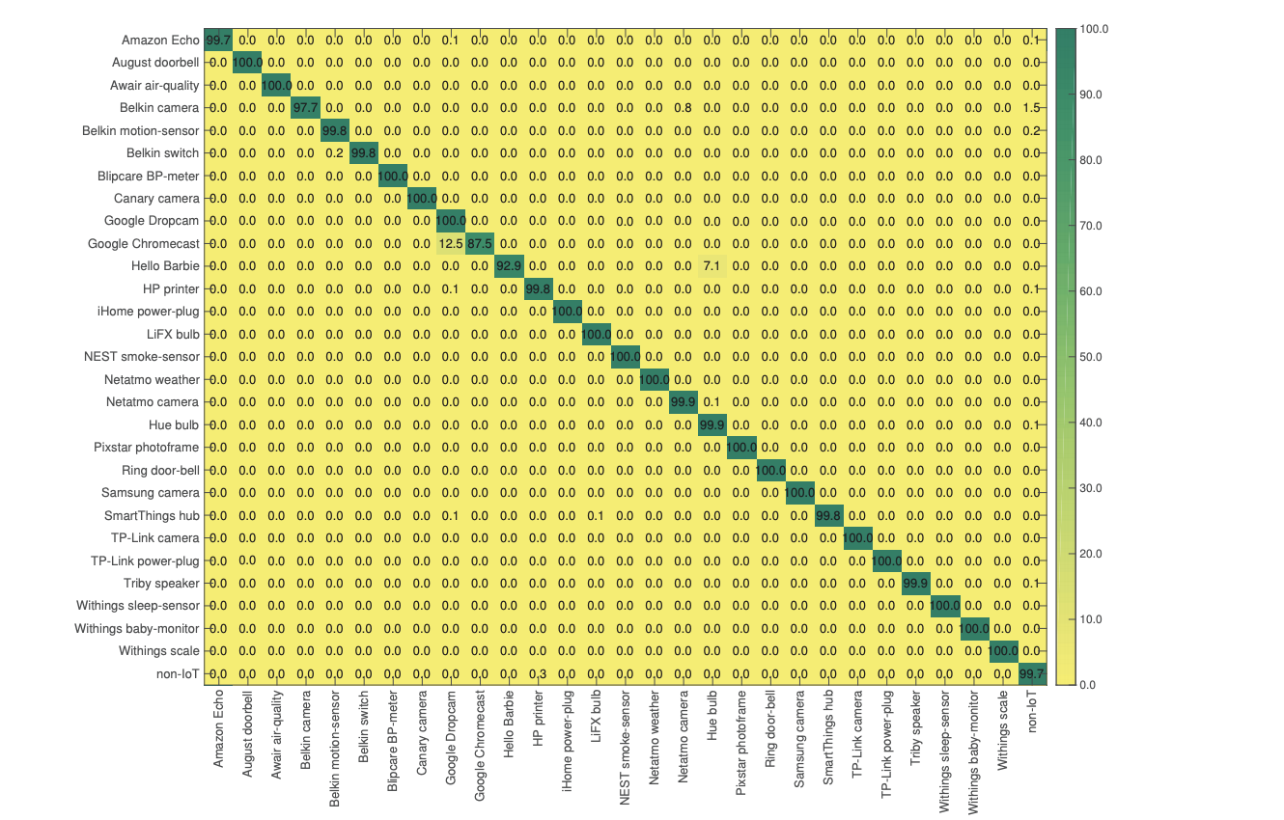
Device detection
~99% accuracy

Slide 49
Infer device activities
Feature:
Traffic burst
Packet size
Packet sequence
Throughput
Duration
A Smart Home is No Castle: Privacy Vulnerabilities of Encrypted IoT Traffic, Noah Apthorpe, Dillon Reisman, Nick Feamster

Slide 50
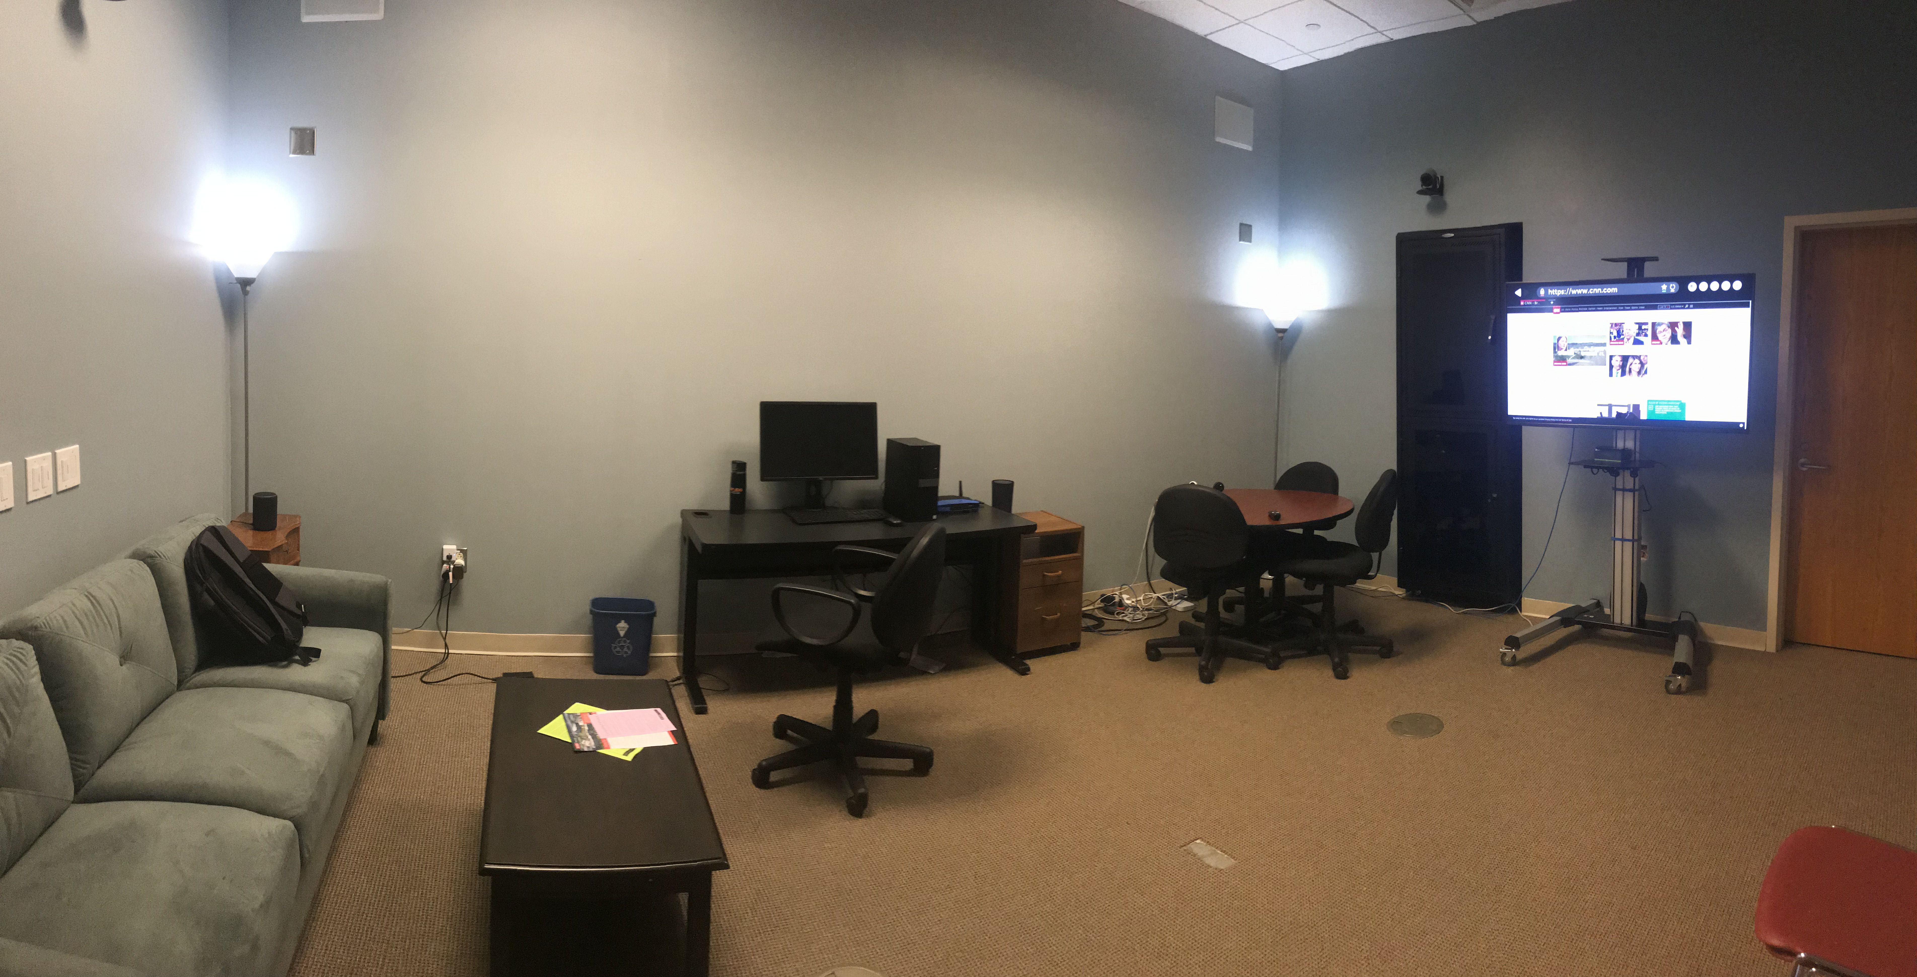
We have our own smart living room lab!
Smart plugs
Smart lights
Smart TV
Alexa Echo
Alexa Echo Look
NestCam
DoorRing bell
Motion Sensors
Door Sensors
SmartThingHub
Google OnHub
Lab will act a testbed to facilitate IoT relevant research

Slide 51
Ongoing IoT related Projects
Infer human activities from network traffic
GDPR compliance of IoT services
Analyzing the Alexa skill eco-system
Automatically vetting Alexa skill permissions
Tracking ecosystem for IoT

Slide 52
Logistics
Project Final Report Nov. 16 @11:59pm
Final Exam On Nov. 19 (9am-11am) on Moodle
More on this next week (also have a review class on Tuesday)
Class evaluation (please complete)
Survey Link => http://go.ncsu.edu/cesurvey

